Slide 1

Managing Strategy and Strategic Planning
The Nature of Strategic Management
Strategy: a comprehensive plan for accomplishing an organization’s goals.
Strategic management: a comprehensive and ongoing management process aimed at formulating and implementing effective strategies; it is a way of approaching business opportunities and challenges.
Effective Strategy: A strategy that promotes a superior alignment between the organization and its environment and between the organization and the achievement of its strategic goals.

Slide 2
The Components of Strategy
Distinctive components: an organizational strength possessed by only a small number of competing firms.
Scope: when applied to strategy, it specifies the range of markets in which an organization will compete.
Resource deployment: how an organization will distribute its resources across the areas in which it competes.

Slide 3
Types of Strategic Alternatives
Business-level strategy is the set of strategic alternatives that an organization chooses from as it conducts business in a particular industry or market.
Corporate-level strategy is the set of strategic alternatives that an organization chooses from as it manages its organization and operations simultaneously across several industries and markets.

Slide 4
Using SWOT Analysis to Formulate Strategy
SWOT: An acronym that stands for strengths, weaknesses, opportunities, and threats.
Organizational strength: a skill or capability that enables an organization to conceive of and implement its strategies.
Common strength: an organizational capability possessed by numerous competing firms.
Distinct Strength: Capability possessed by only one or very few competing firms

Slide 5
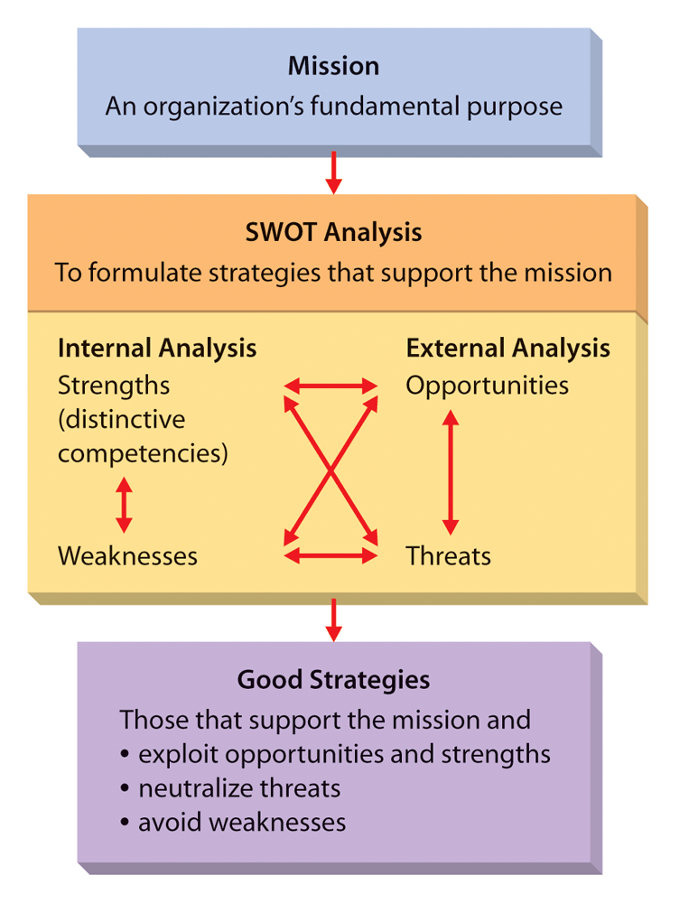
S
W
O
T
Analysis

Slide 6
S W O T Analysis
Evaluating: Strengths, weaknesses, opportunities, threats
Strengths
Strategic imitation: the practice of duplicating another organization’s distinctive competency and thereby implementing a valuable strategy.
Sustained competitive advantage: a competitive advantage that exists after all attempts at strategic imitation have ceased.

Slide 7
Weakness: a skill or capability that does not enable an organization to choose and implement strategies that support its mission.
Competitive disadvantage: a situation in which an organization is not implementing valuable strategies that are being implemented by competing organizations.
Opportunity: an area in the environment that, if exploited, may generate higher performance.
Threats: an area in the environment that increases the difficulty of an organization performing at a high level.

Slide 8
Porter’s Generic Strategies
Differentiation strategy: a strategy in which an organization seeks to distinguish itself from competitors through the quality of its products or services.
Overall cost leadership strategy: a strategy in which an organization attempts to gain a competitive advantage by reducing its costs below the costs of competing firms.
Focus strategy: a strategy in which an organization concentrates on a specific regional market, product line, or group of buyers.

Slide 9
The Miles and Snow Typology
Prospector strategy: a strategy in which the firm is constantly seeking new markets and new opportunities and is oriented toward growth and risk taking.
Defender strategy: a strategy in which the firm concentrates on protecting its current markets, maintaining stable growth, and serving current customers.
Analyzer strategy: a strategy in which the firm attempts to maintain its current businesses and to create new market opportunities.
Reactor strategy: a strategy in which a firm has no consistent approach to strategy.

Slide 10
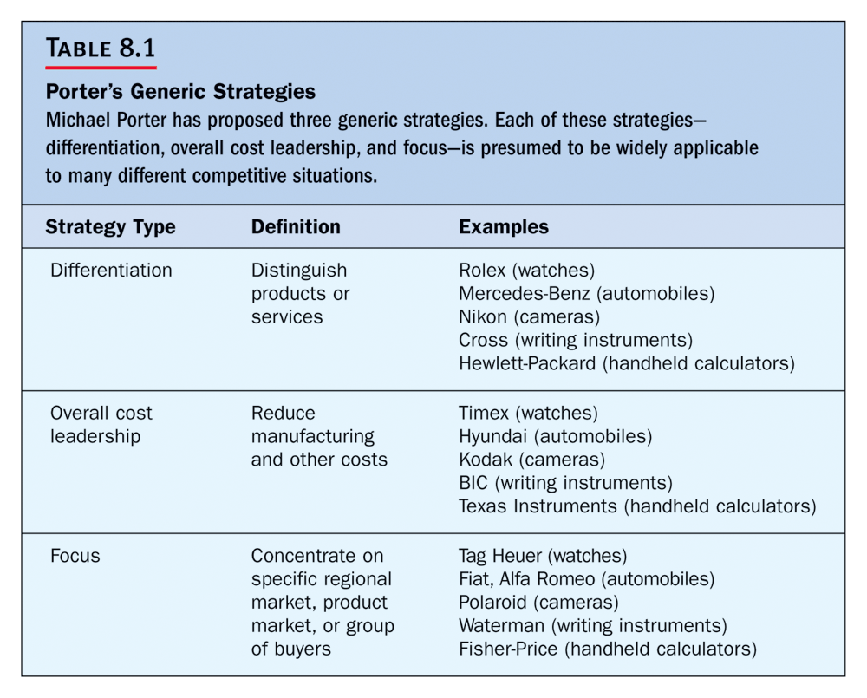

Slide 11
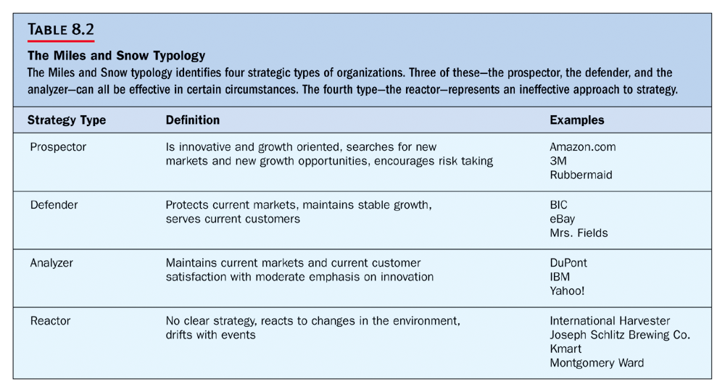

Slide 12
Strategies Based on the Product Life Cycle
Product life cycle: a model that shows sales volume changes over the life of products.
Introduction stage: demand may be very high and sometimes outpaces the firm’s ability to supply the product.
Growth stage: more firms begin producing the product, and sales continue to grow.
Mature stage: overall demand growth begins to slow down.
Decline stage: demand for product decreases.

Slide 13
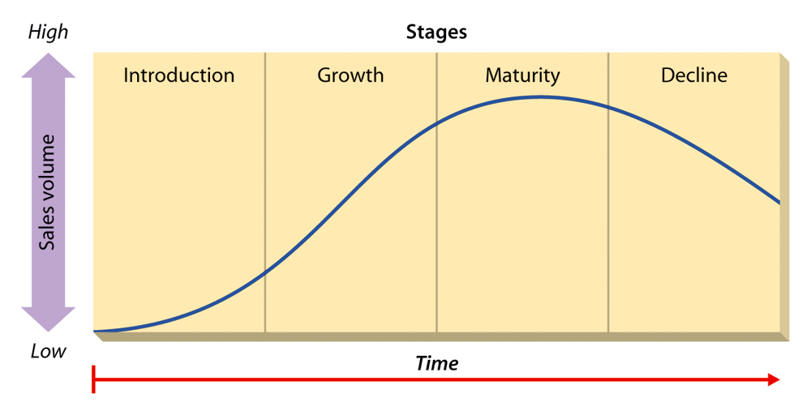
Figure 8.2: The Product Life Cycle
Insert Figure 8.2

Slide 14
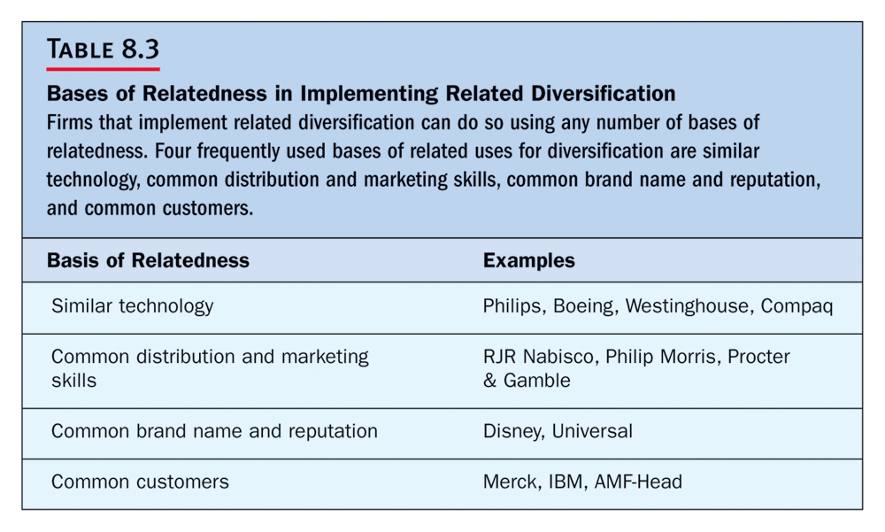

Slide 15
Formulating Corporate Level Strategies
Single-product strategy: a strategy in which an organization manufactures just one product or service and sells it in a single geographic market.
Diversification: the number of different businesses that an organization in engaged in and the extent to which these businesses are related to one another.
Related diversification: a strategy in which an organization operates in several different businesses, industries, or markets that are somehow linked.
Unrelated diversification: when a firm operates multiple businesses that are not logically associated with one another.

Slide 16
Implementing Corporate Level Strategies
Backward vertical integration: an organization begins the business activities formerly conducted by its suppliers.
Forward vertical integration: an organization stops selling to one customer and sells instead to that customer’s customers.
Merger: the purchase of one firm by another of the same size.
Acquisition: the purchase of a firm by another that is considerably larger.

Slide 17
International and Global Strategies
International firms can improve their efficiency through several means not accessible to a domestic firm.
Location efficiencies, by locating their facilities anywhere in the world that yields the lowest costs.
They may also lower costs by capturing economies of scale.
By broadening their product lines they can enjoy economies of scope.

Slide 18
Multinational Flexibility
Unlike domestic firms which operate in and respond to changes in the context of a single domestic environment, international businesses may also respond to a change in one country by implementing a change in another country.

Slide 19
Worldwide Learning
The diverse operating environments of multinational corporations may also contribute to organizational learning.
Differences in these operating environments may cause the firm to operate differently in one country than another.

Slide 20

Strategic Alternatives for International Business
Home replication: a firm utilizes the core competency or firm specific advantage it developed at home as its main competitive weapon in the foreign markets that it enters.
Multi-domestic strategy: a corporation manages itself as a collection of relatively independent operating subsidiaries and is free to customize its products, its marketing campaigns, and operating techniques
to meet local customer needs.

Slide 21

Global Strategy
A global corporation views the
world as a single marketplace
and has as its primary goal the
creation of standardized goods
and services that will address
the needs of customers worldwide.
Transnational strategy: the transnational attempts to combine the benefits of global scale efficiencies, such as those pursued by a global corporation, with the benefits and advantages of local responsiveness, which is the goal of a multi-domestic corporation.

Slide 22
Managing Diversification
A method that diversified
Organization use to make
decisions about what
businesses to engage in and how
To manage these multiple
businesses to maximize
corporate performance
Portfolio
management
technique
BCG
matrix
A method of evaluating businesses
relative to the growth rate of
their market and the organization’s
share of the market

Slide 23
Replacement of Suppliers and Customers
Backward
Vertical
Integration
An organization’s beginning the
business activities formerly conducted
by its suppliers
Forward
Vertical
Integration
An organization stops selling to one
customer and sells instead to that
customer’s customers

Slide 24
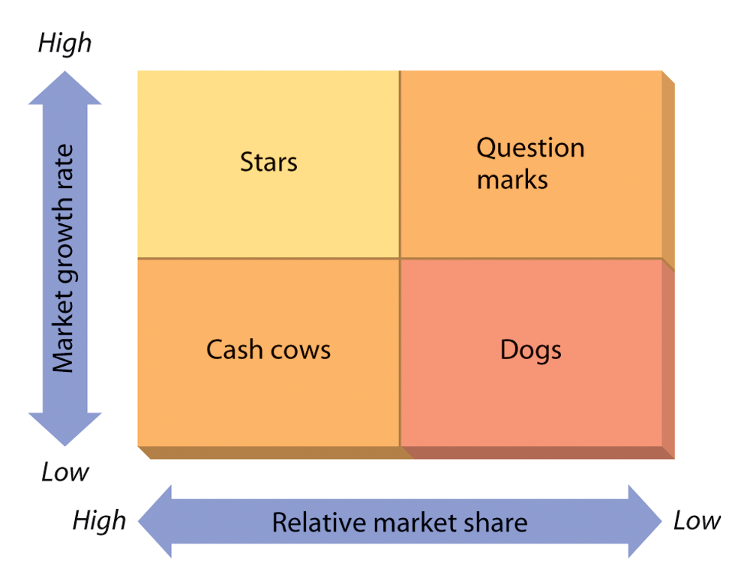
Figure 8.3: The BCG Matrix

Slide 25
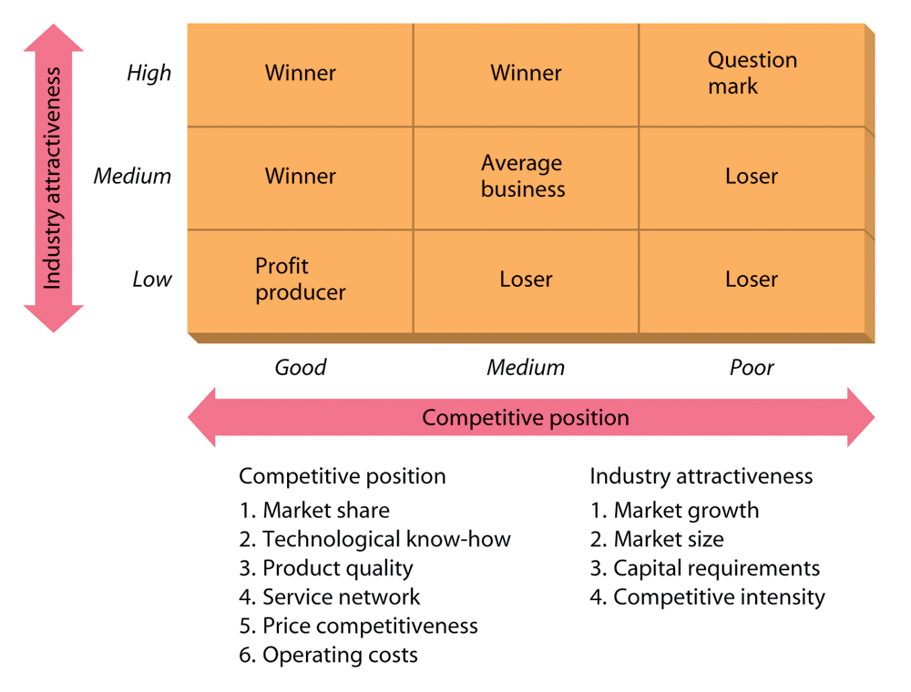
Figure 8.4: The GE Business Screen

